Slide 1
Standard Small Satellite Platform for Life Sciences Research
Optics: Brandon Triplett – John Semmen
CpE: Jennifer Starling EE: Nick Hubbard

Slide 2
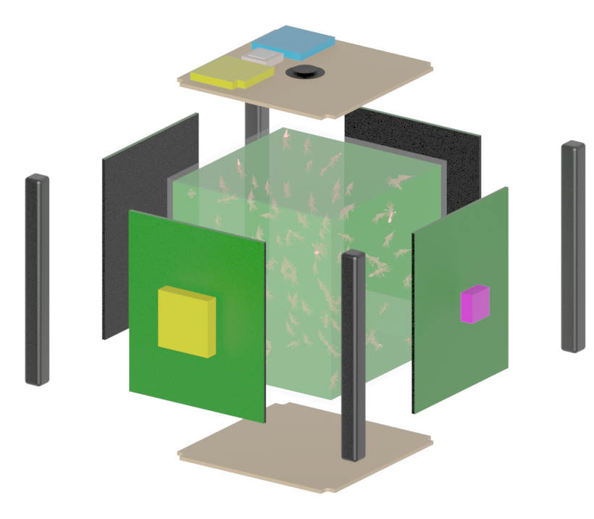
What is it?
Remote-controlled research vessel for aquatic life.

Slide 3
Motivation
Gain an understanding of how animals react to microgravity environments.
This is essential to understanding how humans will react to micro-gravity environments, which is the key take away from the potential research.
High effort senior design project that may also serve as a foundation for a real NASA experiment.

Slide 4
Goals and Objectives
Suite will use electronic and optical sensors to observe:
Dissolved oxygen - Optode
Salinity - Refractometer
Ammonia - Camera
Average water temperature – Thermometer
Algae color – Camera
The overall goal is to demonstrate these capabilities and provide groundwork to be built into a better system for a real experiment.

Slide 5
General specifications
Should fit the dimensions of a 6U CubeSat (approximately 60x10x10 cm).
Should weigh less than: 10kg.
Should operate from battery power.
Should transmit data.
Should cost less than $1600 to build

Slide 6
Specifications continued
Optode: detect oxygen levels within 100 nanomoles.
Refractometer: detect freshwater from saltwater (far-reach goal: 5 PPT salinity resolution)
Ammonia sensor: detect levels at a 0.5mg/L concentration.
Thermometer: temperature resolution of 0.25°C; accurate within 0.25°C.
Camera: smaller than 64cm^{3.}
Transmitter: 100-meter range.
Receiver: sensitivity of –140dBm.
Power: battery should supply system for 1 hour
Heater: able to prevent freezing

Slide 7
Selected Demonstrations
We will demonstrate the ability to take the five suggested measurements (dis-solved oxygen, salinity, ammonia (NH3), average temperature, algae color) by demonstrating a working refractometer, optode, thermometer, and camera and record that data to the systems computer.
The prototype will be placed in a freezer where the computer will detect freezing temperatures and turn on the heater to prevent the aquarium from freezing, at environment temperatures below 0°C.
The transmitter will successfully send and receive data at a range of 100 meters.
Additionally, the following demonstrations will be attempted as a bonus:
The refractometer will distinguish saltwater from freshwater (an estimated 0.006difference in refractive index).
The computer will receive a cease transmissions signal and shut off the transmitter as required by the FCC.
The optode will detect the oxygen levels within 100 nanomoles.

Slide 8
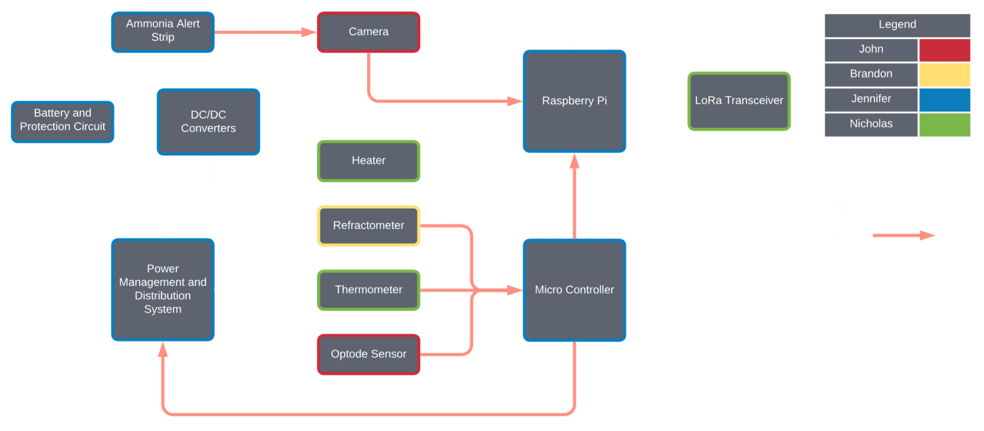
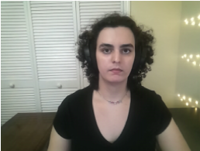
Hardware Block Diagram

Slide 9
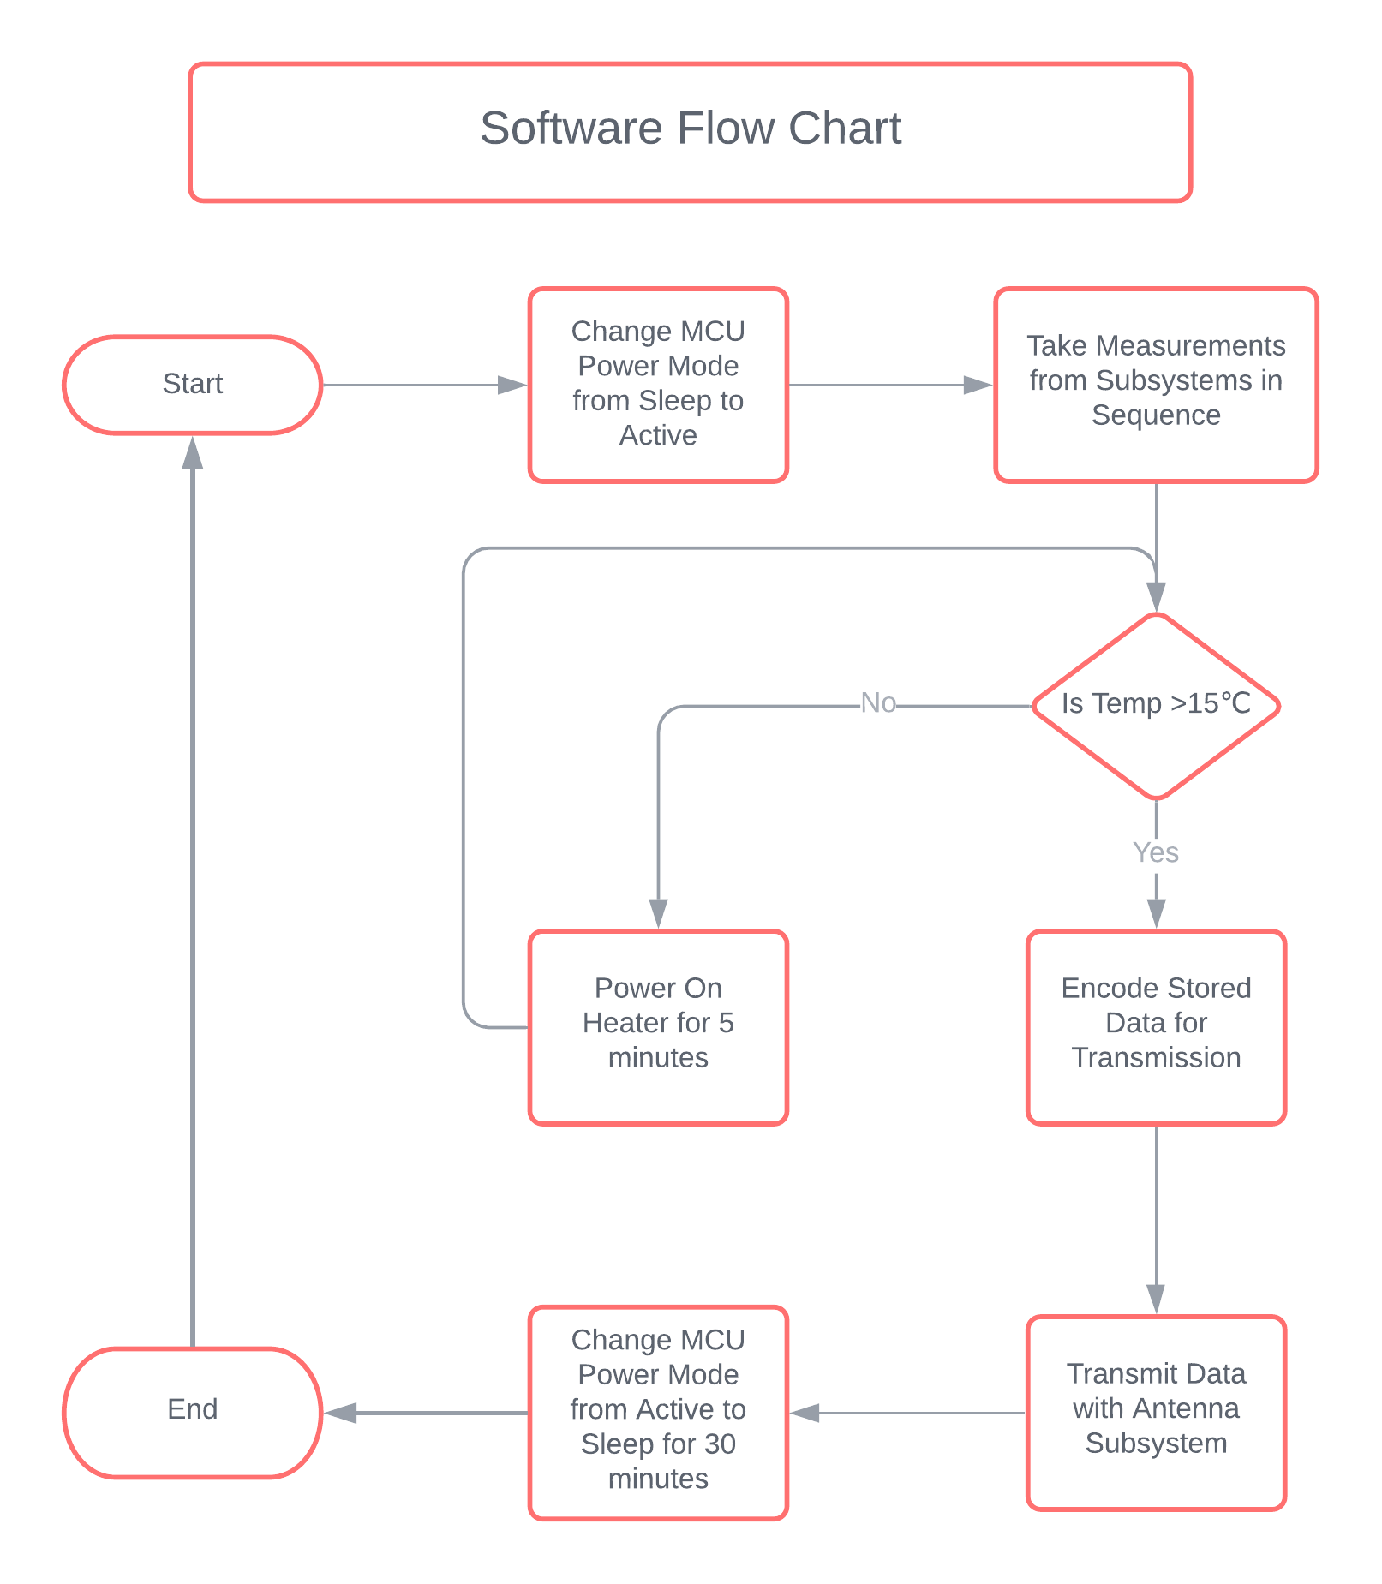
Software Flowchart

Slide 10
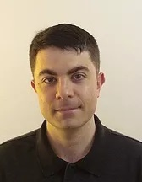
Chassis Design and Component Placement
- CubeSats are built to size using the dimension measurement of "U"
- This unit measures 10x10x10 cm and approximately 1.33 kg per "U"
- 6U was chosen as this experiment is a proof of concept
- 6U means we have 60x10x10 cm to build inside of

Slide 11
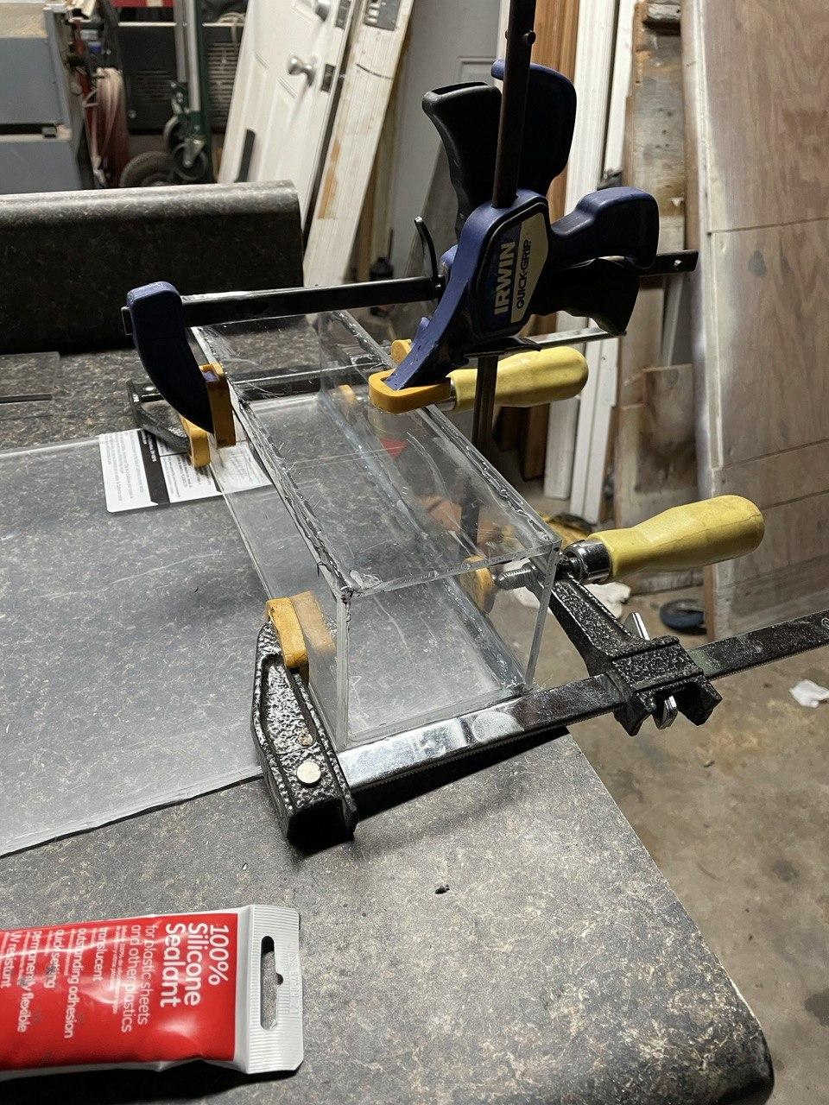
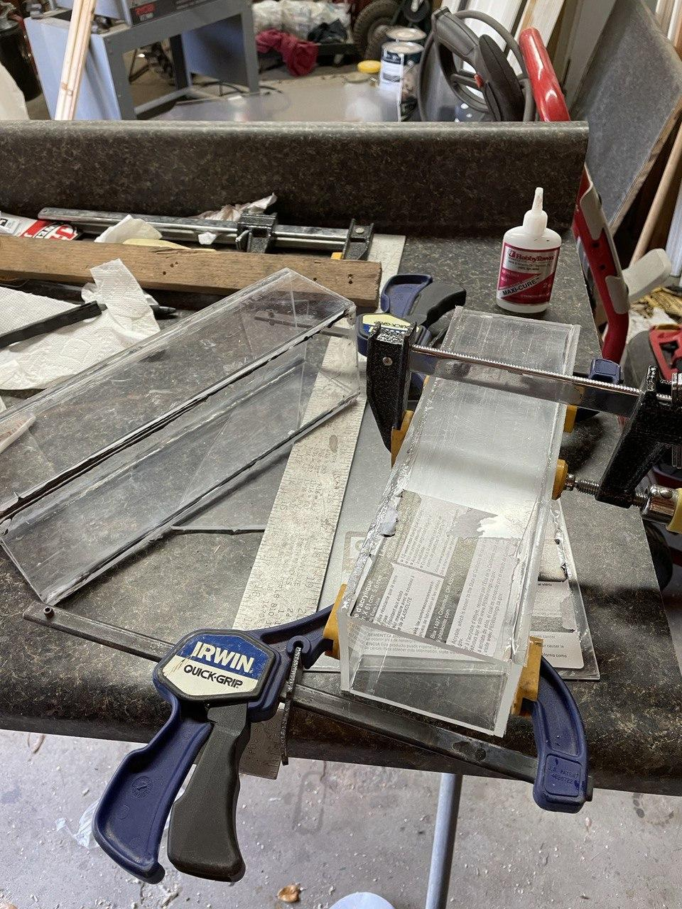
Chassis Progress
Epoxy (second attempt)
CA glue (third/final attempt)
Dimensions: 30x8x8 cm
Material: 5.5 mm thick acrylic

Slide 12
MakerBeam Kit
Individually customizable beams
There are no fixed positions
50mm, 100mm, 150mm, 200mm, 300mm Lengths
10mm x 10mm Width and Height
Most CubeSats have insertable tray configurations
Commonly used with 3D printers since it can be adjusted
Enclose the sides with Aluminum Sheeting

Slide 13
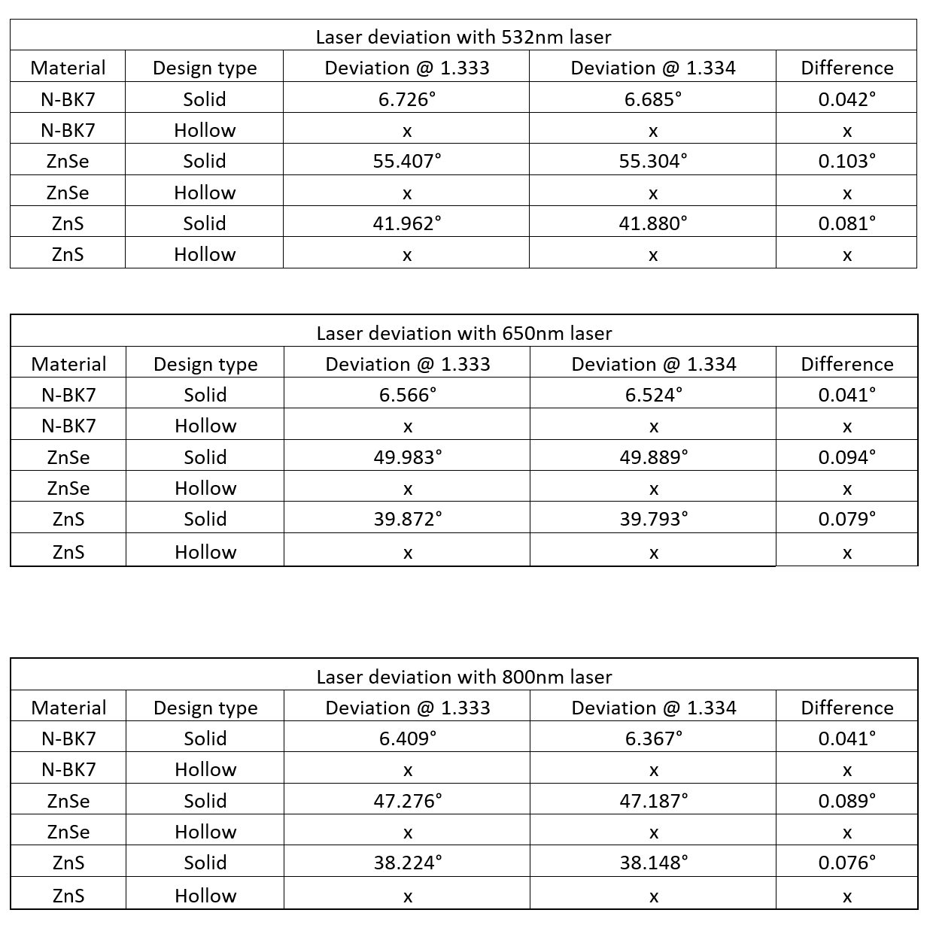
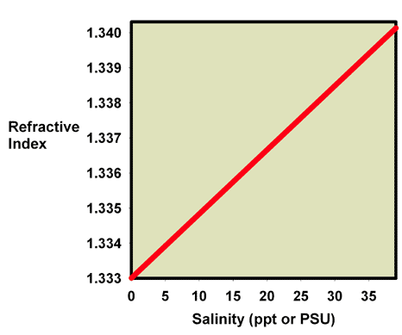
Refractometer Considerations

Slide 14
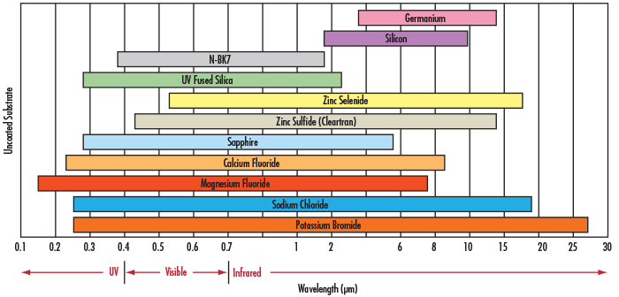
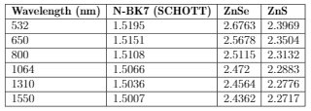
Refractometer Considerations

Slide 15
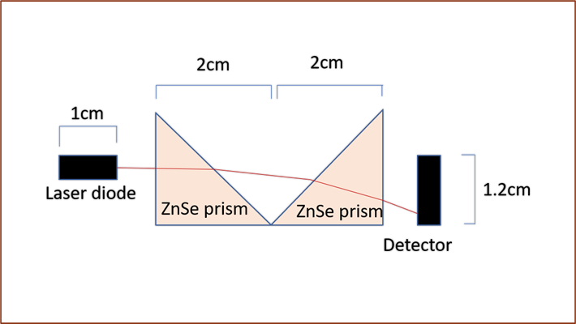
Refractometer Layout

Slide 16
Position Sensor Circuitry

Slide 17
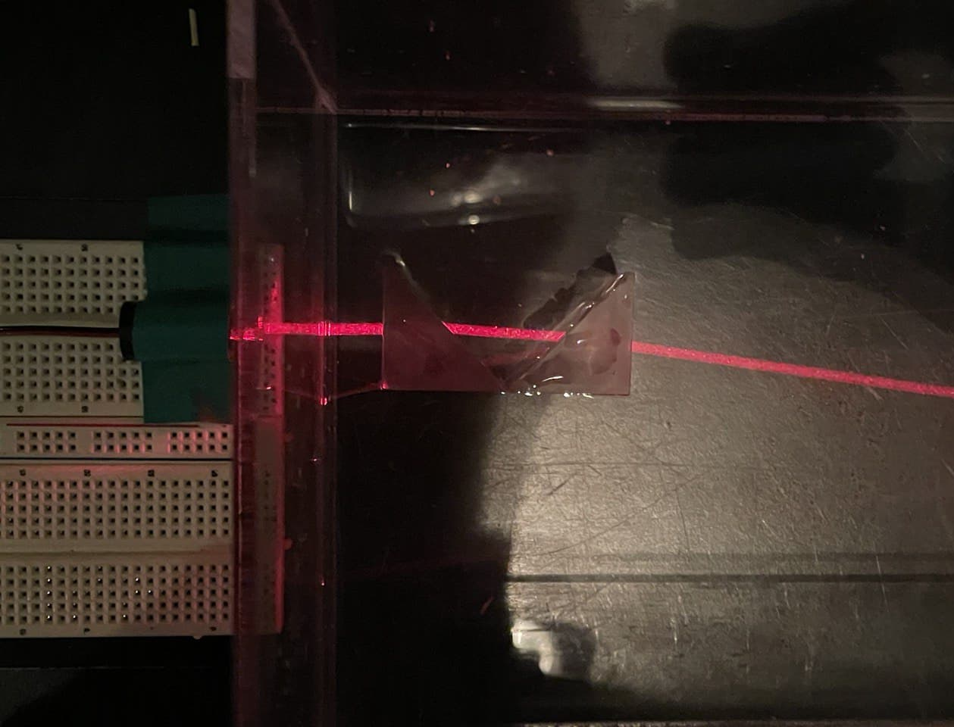
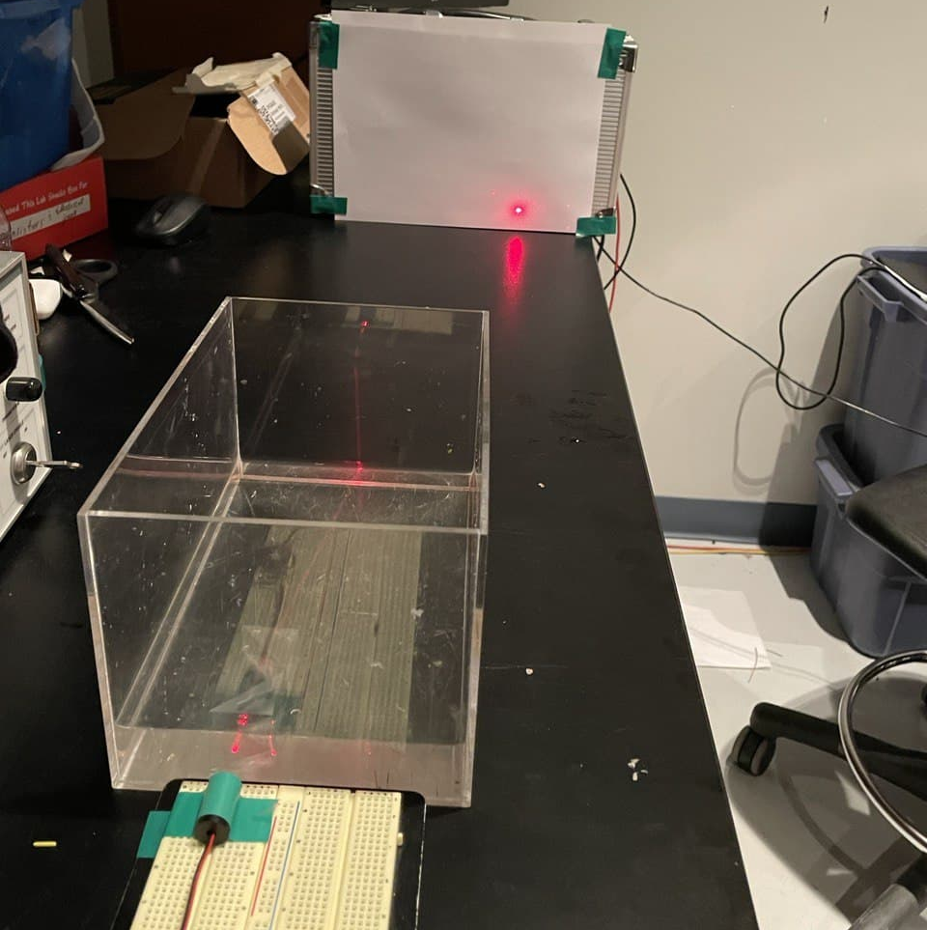
Refractometer Testing

Slide 18
Refractometer Testing

Slide 19
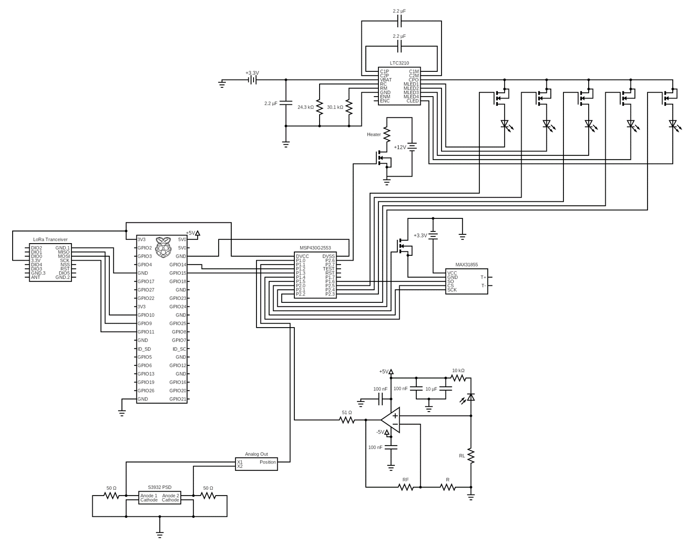
Hardware Schematic

Slide 20
Hardware Schematic
Raspberry Pi Zero
MCU

Slide 21
Hardware Schematic
Ra-02 SX1278
Thermistor Amplifier
Optode Circuitry
Refractometer Circuitry

Slide 22
Hardware Schematic
MOSFETs for Power Management and Distribution Control

Slide 23
Hardware Schematic
LED Driver
LEDs for Camera, Optode, and Refractometer

Slide 24
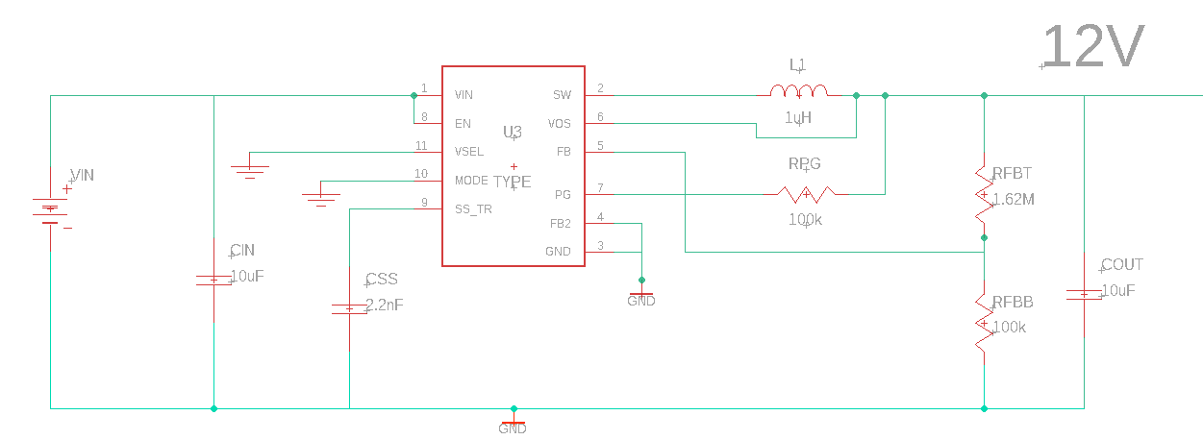
DC to DC Power Converters

Slide 25
Why use LoRa and not ZigBee or other?
Unfortunately, we will not actually be launching this into space, but we still wanted to demonstrate a longer range than a typical remote sensor reading.
Need to be able to take accurate readings remotely from 500 meters
Both are low power
High Sensitivity (-150dBm vs. -100dBm)
LoRa has longer range and does not require line of sight

Slide 26
Transmission Regulations
Funding from NASA
Belongs to students
Operated by students
Follow FCC Process

Slide 27
ITU Regions
Available frequencies are based on geographical areas to prevent interference.
We are in Region 2

Slide 28
UHF 70cm Band
433 MHz chosen
Common amateur band
Readily available and cheap components
FCC Technician License required (Test 2/16)

Slide 29
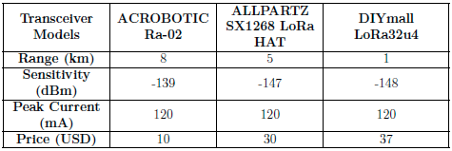
SX1278 137- 525 MHz
Programmable transmission modes depending on bandwidth and spreading factor
Compatibility is based on OEM
Acrobotic chosen for 16-pin Raspberry Pi compatibility
One transceiver at Earth Station and one at Space station connected to Raspberry Pi's

Slide 30
Heating Typical satellites deal with extreme heat and extreme cold. Most solutions are material or mechanical engineering based. Realistic demonstration is a freezer.
Typical Passive Systems on a Satellite
- Heat Pipes
- Thermal Straps
- Sun Shields
- Deployable Radiators
- Thermal Coating to Control Black Body Radiation
These systems are outside our budget and the scope of our studies. Thermal control was a component requested by NASA and so using a heater to prevent freezing was decided as a realistic possible demonstration of an active system.

Slide 31
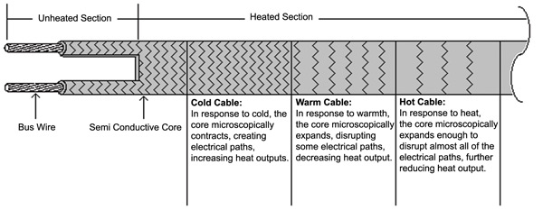
Heating Cable
Can wrap around sphere as needed for sensor visibility
Specifically designed to prevent freezing as water flows through pipes
Designed to be always on
Designed to be attached with bulky tapes
Courtesy of BriskHeat.com

Slide 32
Electrical Resistance Heaters
Flexible
Extremely Small
Quick Heating
1 - 7 Watts Power
5 – 12 Volts
Average around 20-25 Ohms
Up to 180 degrees Celsius
Can easily control power with no additional hardware
Testing needed to decide on a heat plate to prevent direct contact

Slide 33
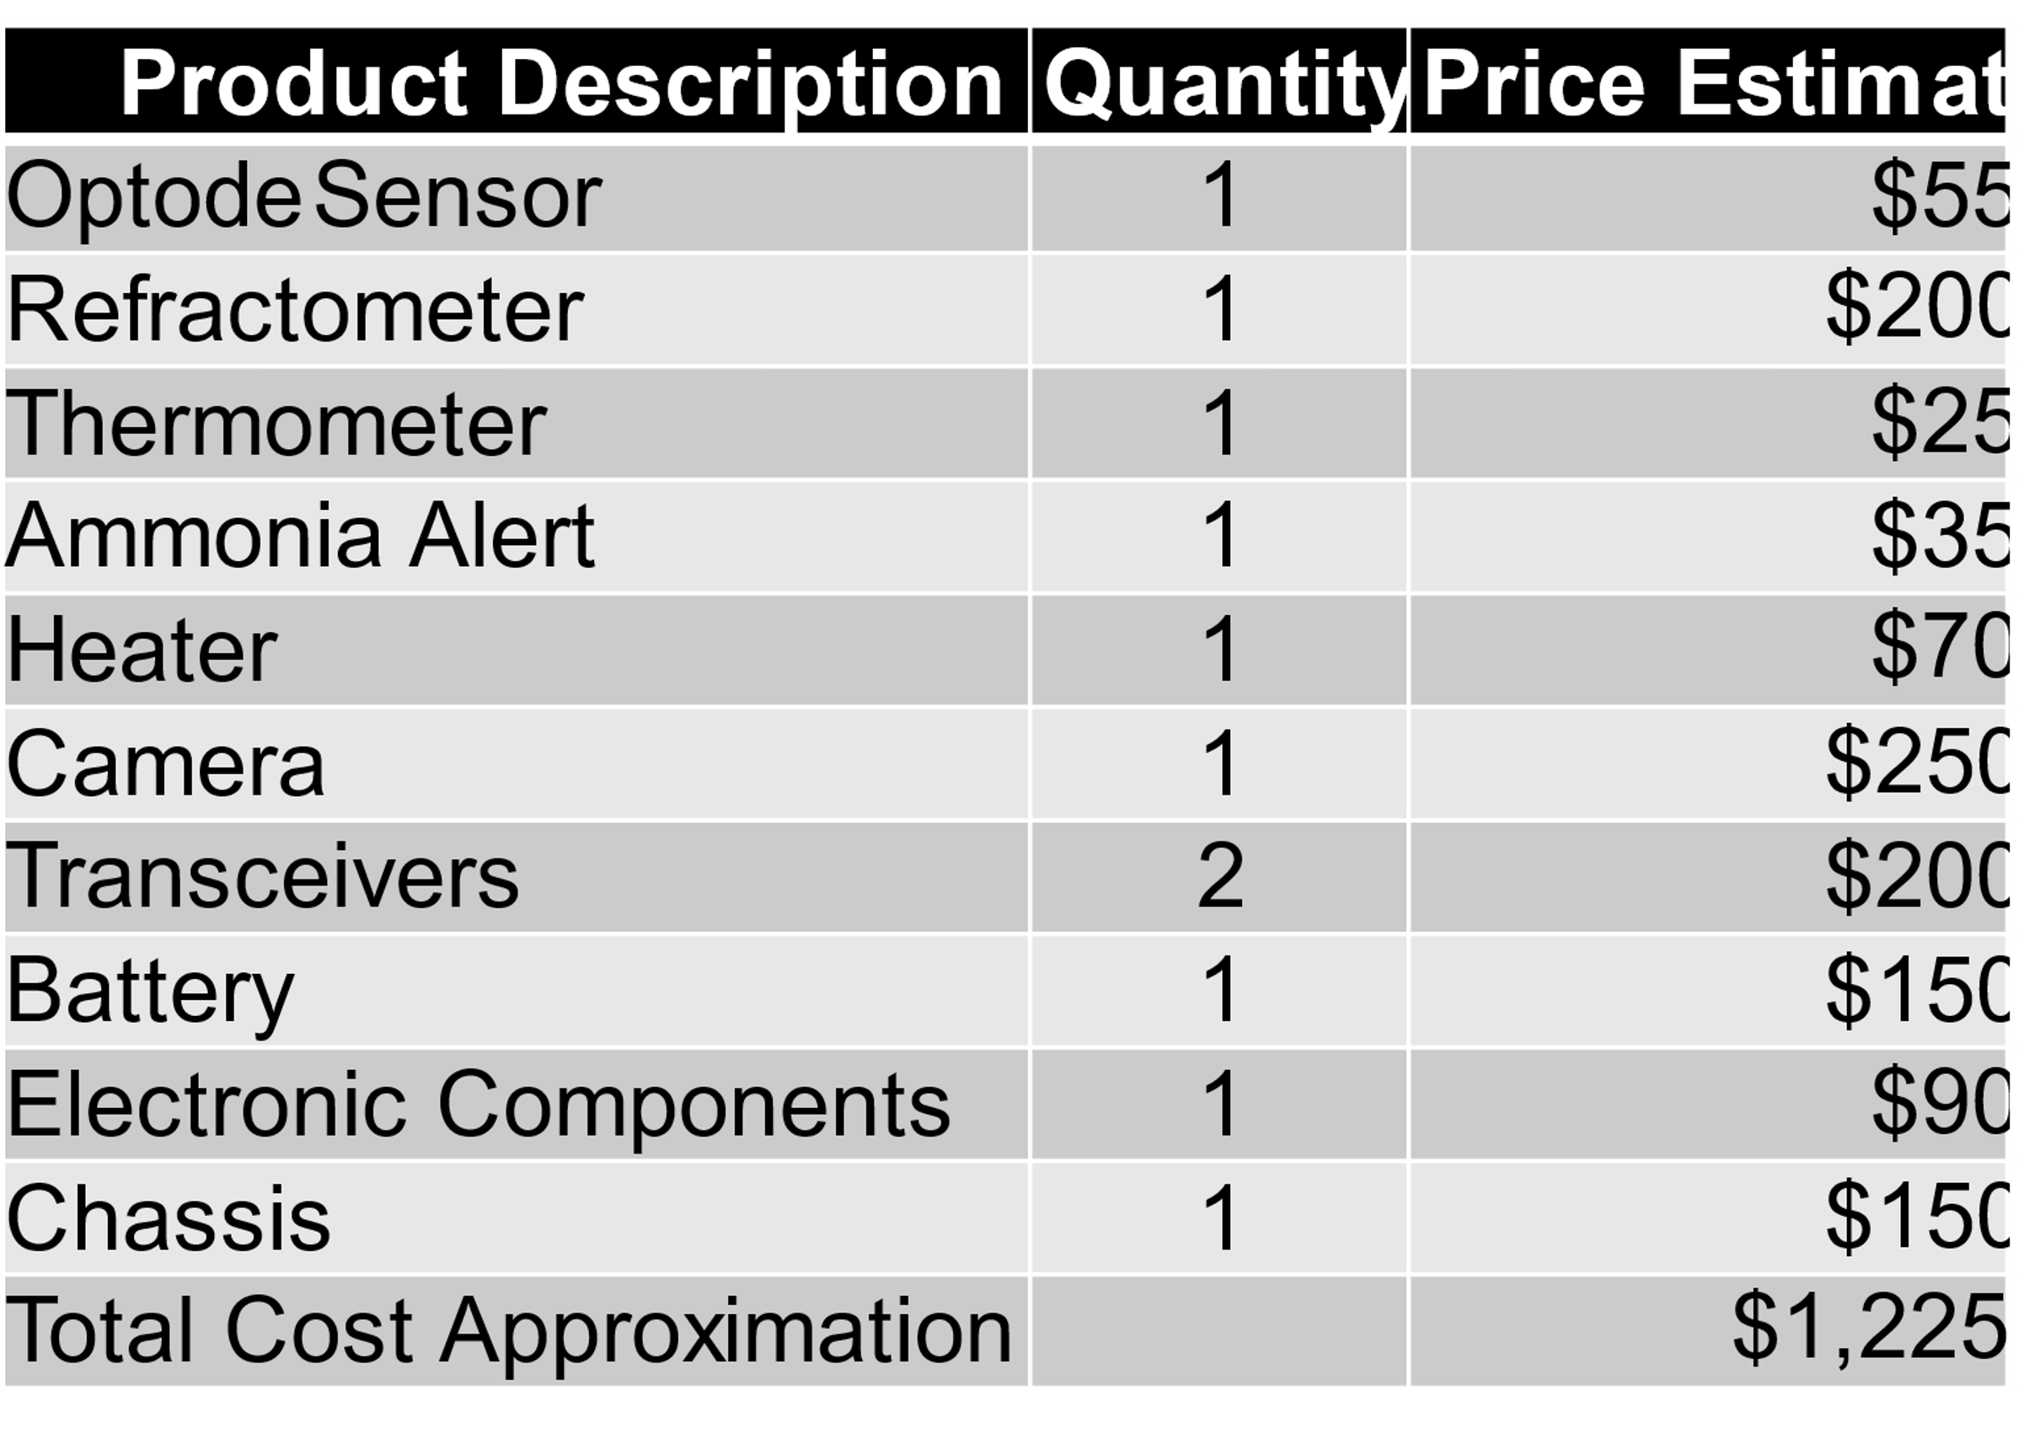
Budget

Slide 34
Challenges
Part of the appeal of working on a NASA sponsored project was the promise of weekly advisor meetings with the Project Sponsor and multiple trips to Kennedy Space Center. Unfortunately, whether due to Covid or other reasons, none of this came to fruition.
Additional proposals were required to be written to obtain the sponsorship
Design decisions put on hold awaiting input from the sponsor.
Uncertainty with sponsorship funds lead to parts ordering delays
FCC Technician license tests were cancelled because of COVID until online testing was recently approved

